Slide 1
CHAPTER TWO
Main Petrochemicals

Slide 2
Main Petrochemicals
What are Petrochemicals?
➲ How Petrochemicals are obtained?
➲ Why we need to study Petrochemicals?
➲ What are the applications of Petrochemicals?

Slide 3
2.1. Introduction to petrochemicals
What are Petrochemicals?
A petrochemical is any chemical (as distinct from fuels and petroleum products) manufactured from petroleum and used for a variety of commercial purposes.
They are non-fuel chemical compounds derived from petroleum.
These chemicals include a large no of organic compounds (aliphatic & aromatic) of various functional groups.

Slide 4
2.1. Introduction to Petrochemicals
Primary petrochemicals include:
olefins (ethylene, propene, and butadiene)
aromatics (benzene, toluene, & xylene), &
 methanol.
Thus, petrochemical feed-stocks can be classified into different groups: olefins, aromatics, and methanol;
a 4th group includes inorganic compounds & synthesis gas.

Slide 5
Introduction to petrochemicals
The common products made from petrochemicals include:
 plastics, soaps, detergents, solvents, adhesives
 paints, drugs, fertilizer,
 pesticides, insecticides, explosives,
 synthetic fibers, synthetic rubber,
 flooring, and insulating materials.

Slide 6
2.2. Chemical Conversions for Manufacture of Petrochemicals
The conversion of refinery feedstock into final products involves three main stages.
1st stage is the manufacture of the base chemicals or the building blocks .
e.g. ethylene, propylene, benzene.
Then they are converted into intermediate products
e.g. ethanol, ethylene glycol, propylene glycol, styrene, etc.
3rd stage, these intermediate are then further converted into products that are used directly by industry to produce finished consumers products.
e.g. polyethylene, polypropylene, polystyrene, polyvinylchloride

Slide 7
cont^{d}
The base chemicals can be broadly classified into two groups: olefins and aromatics.
Olefins are characterized by chains of C atoms as their backbone while aromatics contain a ring of C atoms at the core of the molecule.
In an olefin plant, the long chained C molecules are cracked into smaller chains, such as C2 (ethylene), C3 (propylene) & C4 (butadienes).
The two cracking methods used are thermal cracking (high temp.) & catalytic cracking, both of which are highly energy intensive.

Slide 8
2.3. Petrochemicals from Methanol, Ethylene, Propylene, Butylenes & BTX
How Petrochemicals can be manufactured from Methanol, Ethylene, Propylene, Butylenes and BTX?
The two petrochemical classes are olefins including ethylene and propylene, & aromatics including benzene, toluene and xylene isomers(BTX).
Oil refineries produce olefins & aromatics by fluid catalytic cracking of petroleum fractions.
Chemical plants produce olefins by steam cracking of natural gas liquids like ethane and propane.

Slide 9
Petrochemicals from Methanol, Ethylene, Propylene, Butylenes & BTX
Aromatics are produced by catalytic reforming of naphtha.
Olefins and aromatics are the building blocks for a wide range of materials such as solvents, detergents, & adhesives.
Olefins are the basis for polymers and oligomers used in plastics, resins, fibers, elastomers, lubricants, and gels.
2.3.1 Primary Petrochemicals
They are divided into three groups depending on their chemical structure:
Olefins include ethylene, propylene, and butadiene.
Ethylene & propylene are important sources of industrial chemicals & used in manufacturing of plastic products similarly, butadiene is used in making synthetic rubber.

Slide 10
cont^{d}
Aromatics include benzene, toluene, & xylenes(BTX).
Benzene is a raw material for dyes & synthetic detergents.
Manufacturers use xylenes to produce plastics & synthetic fibers.
Synthesis gas is a mixture of CO & H₂ used to make NH₃ & methanol.
NH₃ is used to make the fertilizer urea & methanol is used as a solvent & chemical intermediate.

Slide 11
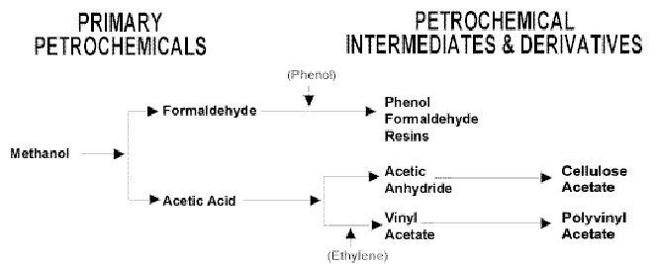
cont^{d}
.

Slide 12
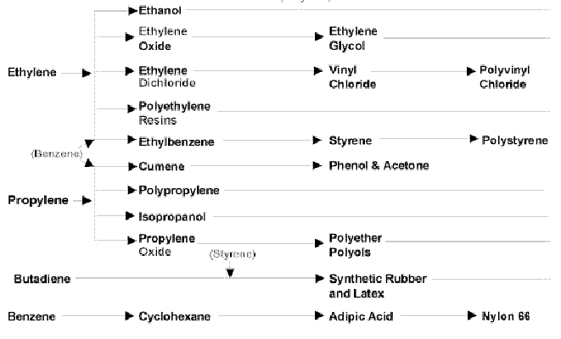
cont^{d}
Benzene

Slide 13

2.4 Manufacture of Acetylene, Ethylene oxide, Acrylonitrile, Dimethylterephthalate
2.4.1 Manufacture of Acetylene (C₂H₂)
C₂H₂ is manufactured from CaC₂ & H₂O.
Besides, there are other methods that can be used for the preparation of C₂H₂.
C₂H₂ is a colorless, combustible gas with a distinctive odor.

Slide 14
cont^{d}
These processes use high temp. (thermal cracking process) to convert the raw materials into a wide variety of gases, including H, CO, CO₂, C₂H₂ and others.
The chemical reaction for converting CH₄ into C₂H₂ & H may be written:

Slide 15
Uses of Acetylene
The most common use of C₂H₂ is as a raw material for the production of various organic chemicals including 1,4-butanediol, which is widely used in the preparation of polyurethane and polyester plastics.
The second most common use is as the fuel component in oxy-acetylene welding and metal cutting.
Some commercially useful C₂H₂ compounds include C₂H₂ black, which is used in certain dry-cell batteries, & acetylenic alcohols, which are used in the synthesis of vitamins.

Slide 16
2.4.2 Manufacture of Ethylene oxide (C₂H₄O)
C₂H₄O is a flammable, colorless gas.
C₂H₄O is found in the production of solvents, antifreeze, textiles, detergents, adhesives, polyurethane foam, and pharmaceuticals.
It is also useful in fumigants, sterilants for spices & cosmetics, as well as during hospital sterilization of surgical equipment.
In industry C₂H₄O is produced while C₂H₂ & oxygen reacting on a silver catalyst at 200–300°C & pressures used are in the region of 1-2MPa.

Slide 17
Uses of ethylene oxide
The chemical compound C₂H₄O is an important industrial chemical used as an intermediate in the production of ethylene glycol, other chemicals, & sterile for the manufacturing of rubber, paint, leather processing, industrial surfactants, paper, textile, metal processing, latex & waxes, household surfactants, detergents, pharmaceutical raw materials, dyeing & finishing, agrochemicals, cosmetics raw material.

Slide 18
2.4.3 Manufacture of Acrylonitrile (C₃H₃N)
Acrylonitrile, vinyl cyanide, CH₂=CHC≡N, is a colorless liquid with a slightly pungent odor.
It was first prepared in 1893 by a French Chemist, Ch. Moreau, by dehydration of ethylene cyanohydrin with phosphorus pentoxide.
It is an important monomer for the manufacture of useful plastics.
Most industrial acrylonitrile is produced by catalytic ammoxidation of propylene by the Sohio process in the presence of a metal-oxide catalyst.

Slide 19
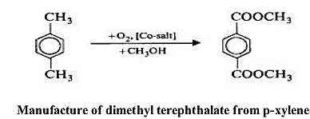
2.4.4 Manufacture of Dimethyl terephthalate (DMT)
The most important commercial route to ester & acid manufacture is the liquid-phase oxidation of p-xylene.
The crude esters are separated into their components in a system of columns under vacuum.
The DMT is further purified by recrystallizing twice from methanol or xylene, melted, and converted into readily manageable flakes with a drum flaker.
DMT is used in the manufacture of polyester fibre, yarn & film and also certain polyester resins.

